Slide 1

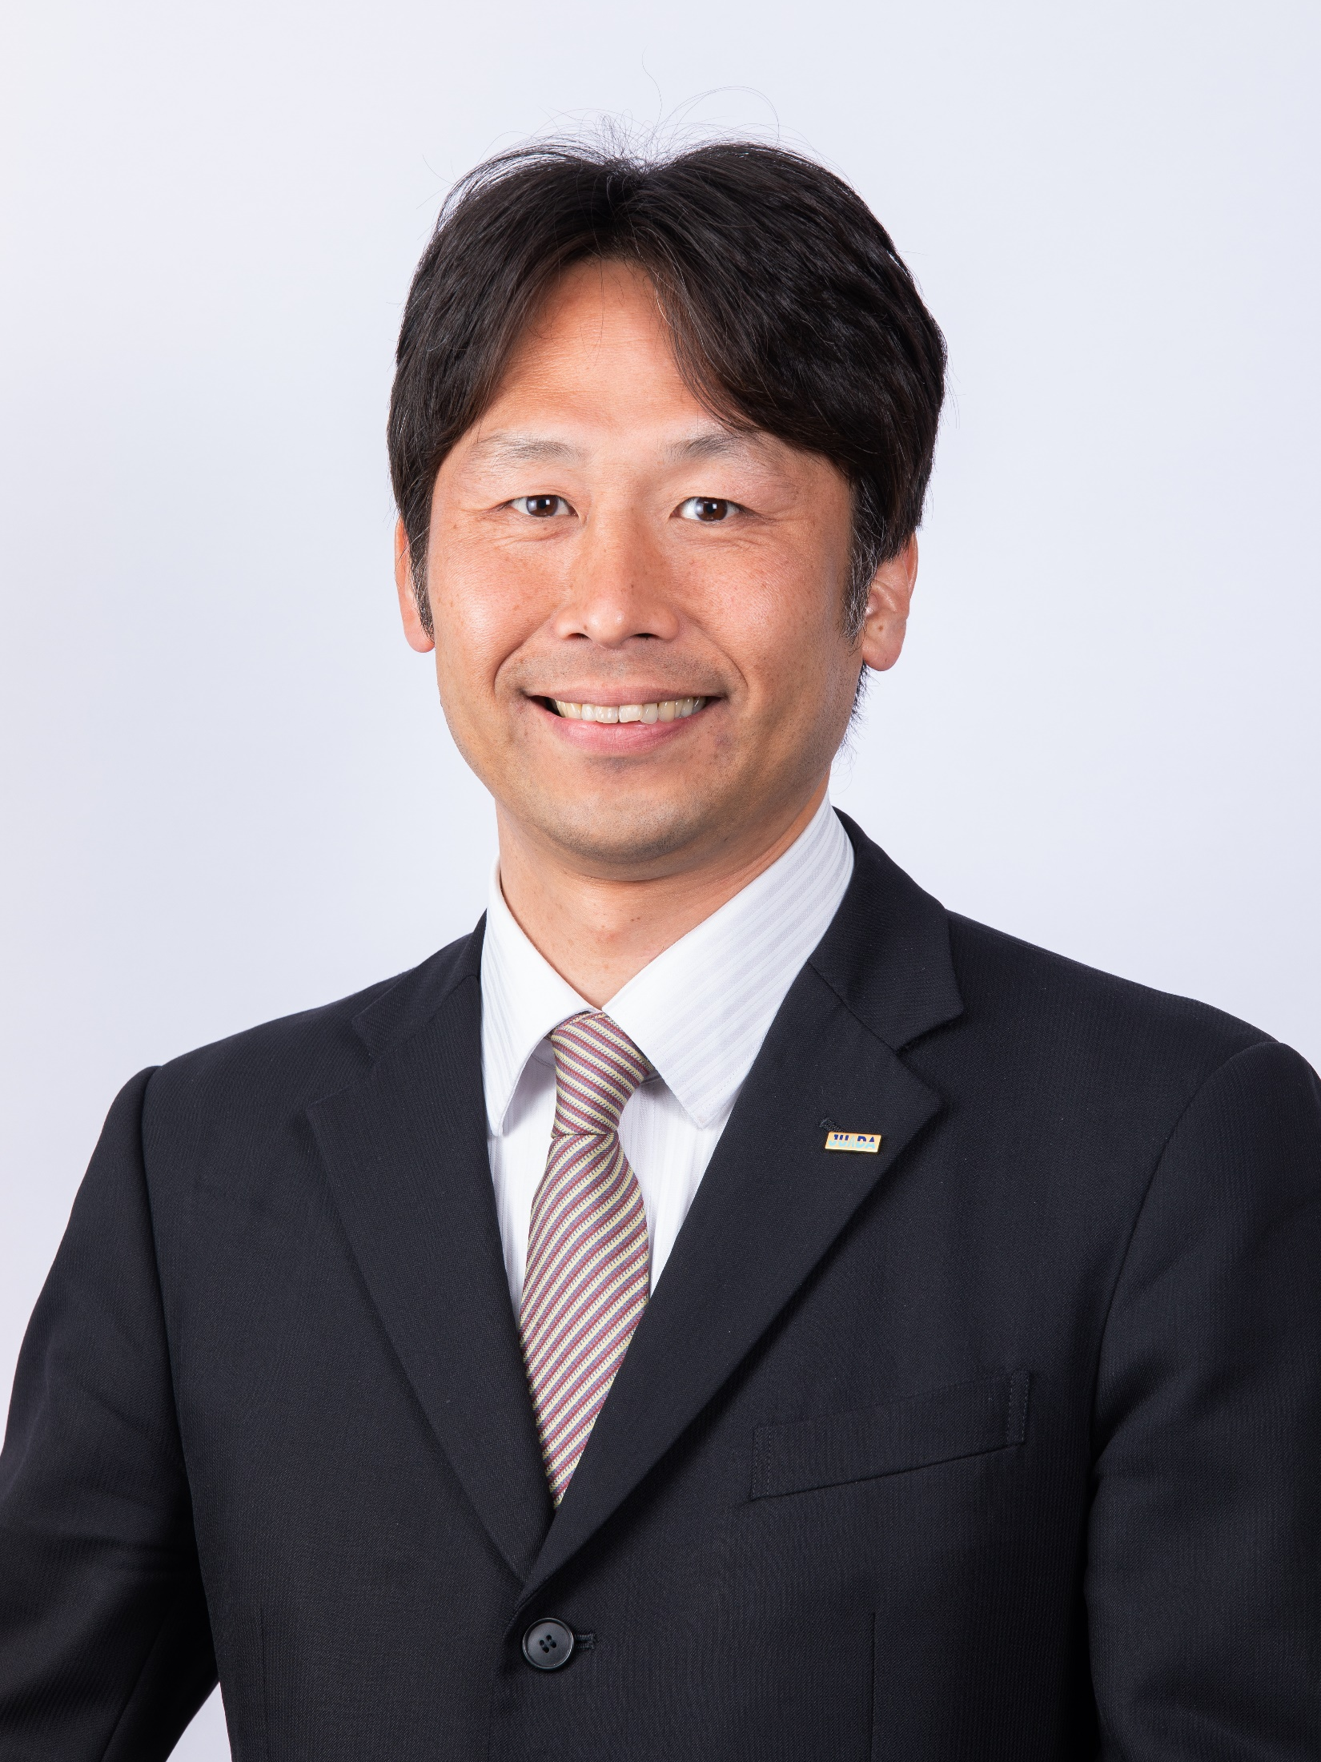
From the future of Drone Safety in Japan
10th September 2020
Dr. Kakuya Iwata
Japan UAS Industrial Development Association

Slide 2








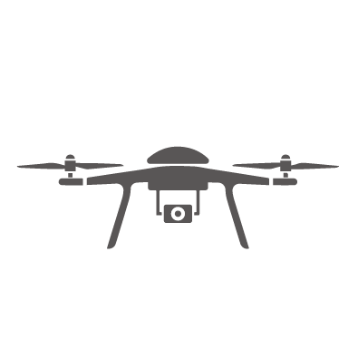
JUIDA’s Activities
①
②
③
④
R&D Support
Commission on Research Work
UAS Safety
Guideline
Training &
Certification
⑤
⑥
⑦
⑧
Seminar &
Events
Test Airfields
Support SME
International
Cooperation

Slide 3
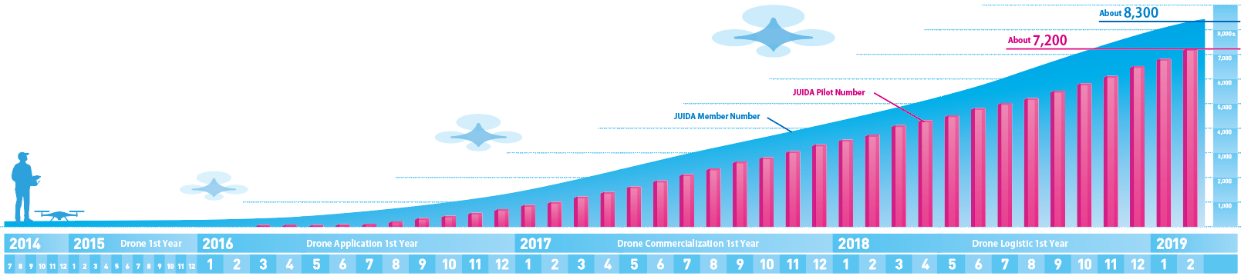
[Confidential]
JUIDA’s History
Pilot
11,922
Safe Flight Administrator
10,483
Instructor
1,332
Corporate
270
Individual
12,371
Public Member
81
※Updated on Jun 2020
Certificates holder:
11,922
Member:
12,722

Slide 4
About Safety: 3 Principles of Aviation Safety
To identify the socially acceptable level of risks, it is necessary to check the risks from three perspectives: the safety of aircraft, the safety of operation, and the safety of systems.
3 Principles of Aviation Safety
Safety of the Aircraft
（Development/Design/Manufacture/Maintenance/Airworthiness Qualification）
e.g. Boeing, Airbus
2. Safety of the Operation
(Skills/Training(Response to Human Error/Emergency))
e.g. JAL, ANA
3. Safety of the System
(Management System/Meteorology/Risk Assessment)
e.g. Narita Airport, Haneda Airport, Control Tower

Slide 5
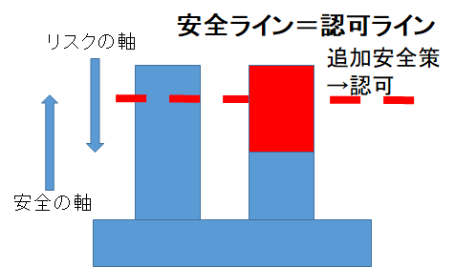
About Safety: Safety Administration Cycle
Socially Acceptable Level of Risks
1. PDCA Cycle
2. OODA Loop
3. V-shape Development Process
Risk Axis
PLAN
V
Safety Axis
V-shape Development Process
DO
ACTION Safety Measures
OBSERVE
PDCA Cycle
ACT
OODA Loop
ORIENT
A team of selected crews with high standards on safety
Pilots (operators of unmanned aerial vehicles) are responsible for DO.
Decide
CHECK
Incident reporting system and non-punitive environment
Accident Analysis
Pilots in Command (Safe Flight Administrators) are responsible for EVERYTHING

Slide 6
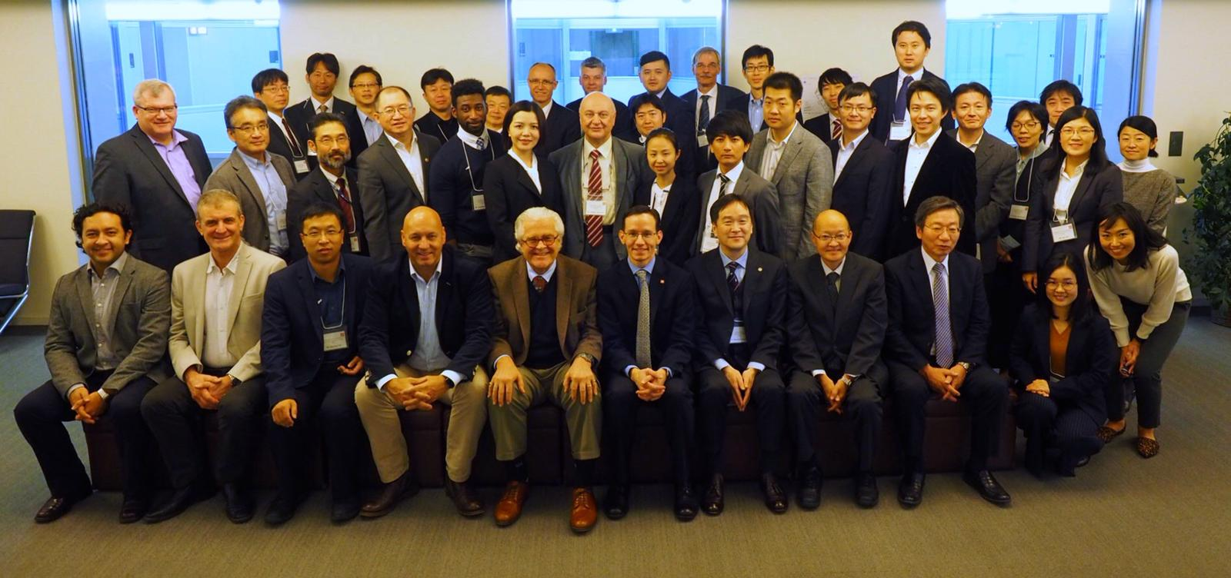
ISO/TC20/SC16 Unmanned Aircraft Systems
Chairperson (until end 2021): Mr. John Walker
Secretariat: United States
Participating countries (17): Belgium, China, Denmark, France, Germany, India, Islamic Republic of Iran, Italy, Japan, Republic of Korea, Russian Federation, Spain, Switzerland, Ukraine, UAE, UK, US
Observer (8): Czech Republic, Ireland, Luxembourg, Netherlands, New Zealand, Poland, Slovakia, Sweden
Established since June 2014
Now involve 17 participating countries and 8 observers.
4 Working Groups (WG)
① General specification
② Product Systems
③ Operational Procedures
(ISO/AWI 23665)
④ UTM
ISO/TC20/SC16
Establishment Confirmed
1
USA
2
UK
3
China
4
Spain
5
Korea
6
USA
7
Japan
8
UK
9
China
2014.6
2015.6
2015.12
2016.6
2017.3
2017.11
2018.6
2018.11
2019.6
2019.11

Slide 7
Different Working Groups of ISO/TC20/SC16
WG1
CD21384-1 Unmanned Aircraft Systems
– Part 1: General specification
Theme set up by the current WG
Theme to be developed in the future
WD21895 Category and classification
WG1
Compliance and Airworthiness Directives
WG2
WG3
WG5
WG4
WD21384-2:
Product systems
WD21384-3: Operational procedures
Testing
UTM
Risk Assessment
Compliance and Airworthiness Matrix
Airspace
General
Guidance, Navigation and Control
NXX Part 4: Airspace below 500 ft.
Architecture and airspace management
Power source
NXX Part 5: Above FL600
UAS managed by UTM
Battery
NXX Part 6: Airspace Guidance System
UTM data transfer
Autonomous UAS
Schools And Other Certificated Agencies
UTM service support
Autonomous Flight
JUIDA proposed the establishment of “Training for personnel involved in UAS operations” under WG3. Under progress. In FY2019, the standard will get an agreement to proceed to Committee Draft ballot.
Identification and Registration
Incident Report
Logistics Operation

Slide 8
JUIDA’s work to ensure Drone Safety

Slide 9



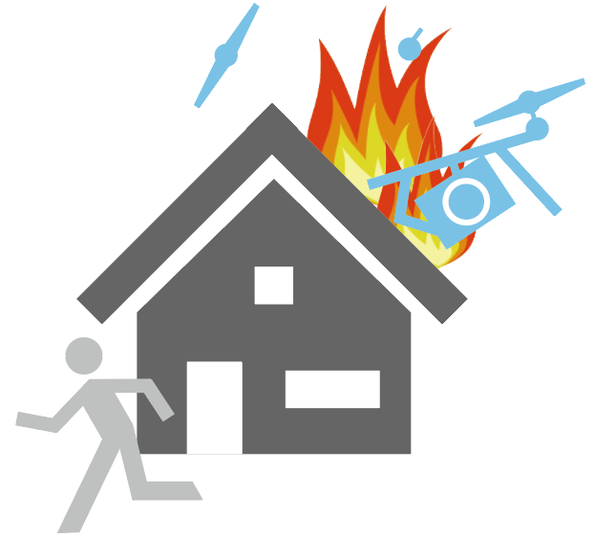
JUIDA Group Insurance
Drone Insurance
3rd Party Liability Damage Insurance
1st in Japan offering this package
Necessary under JUIDA Safety Guidelines
JUIDA members
Preferential treatment for JUIDA certificate holders
※ Details available at JUIDA HP

Slide 10
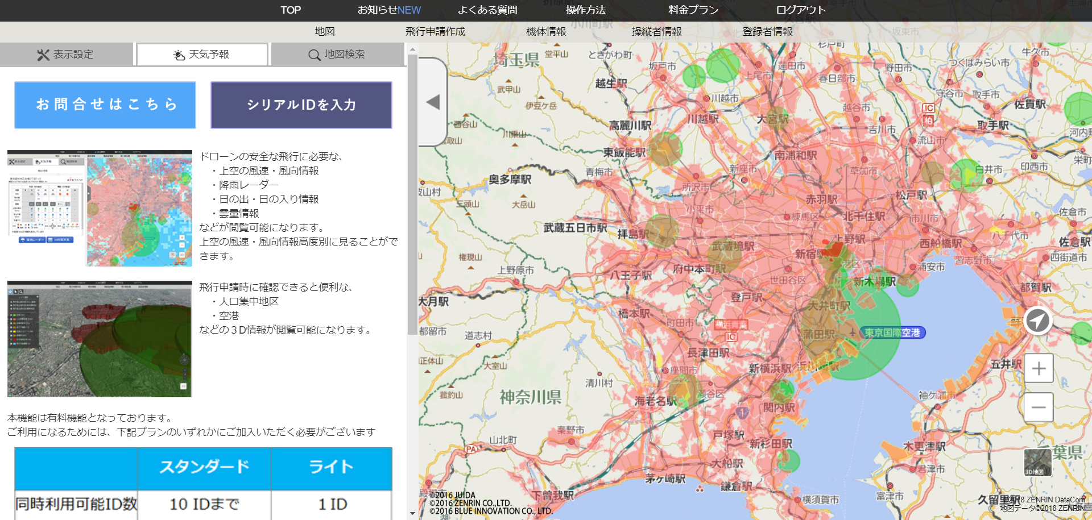

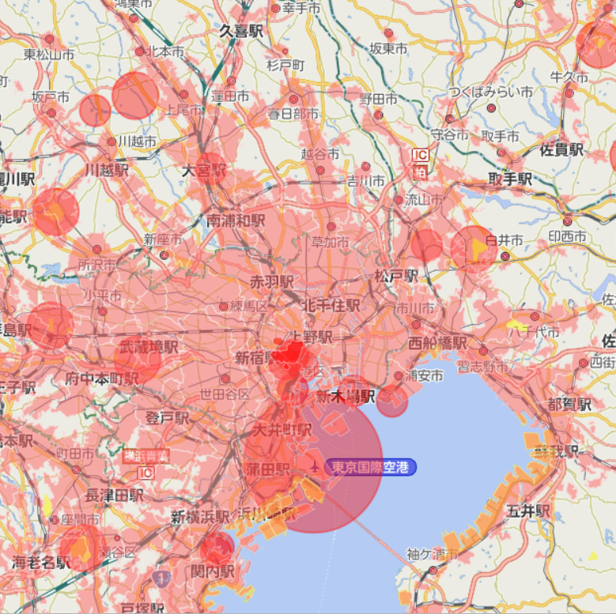
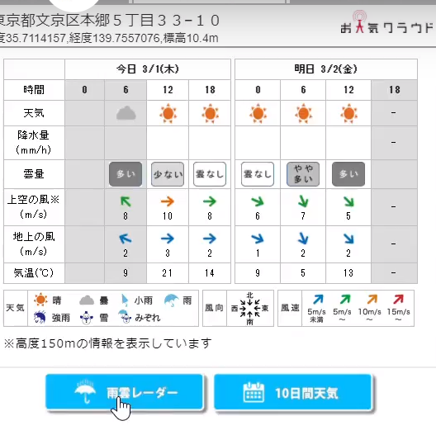
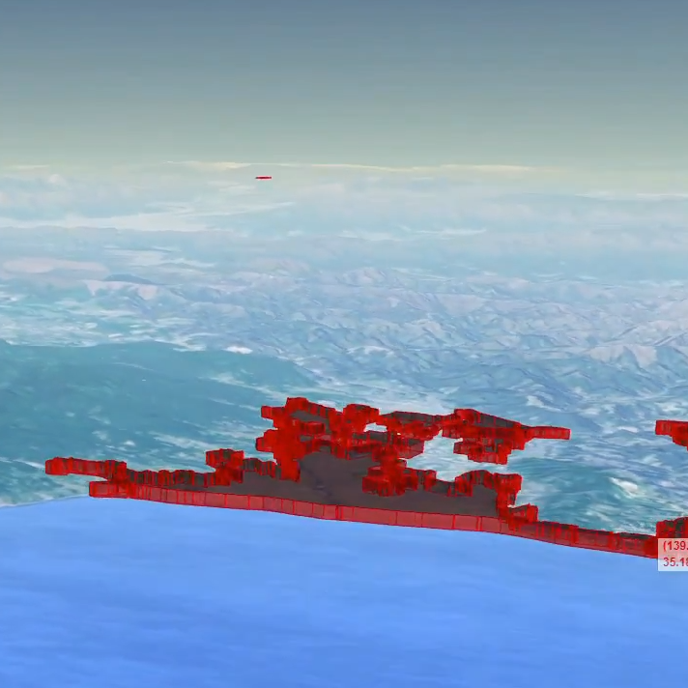
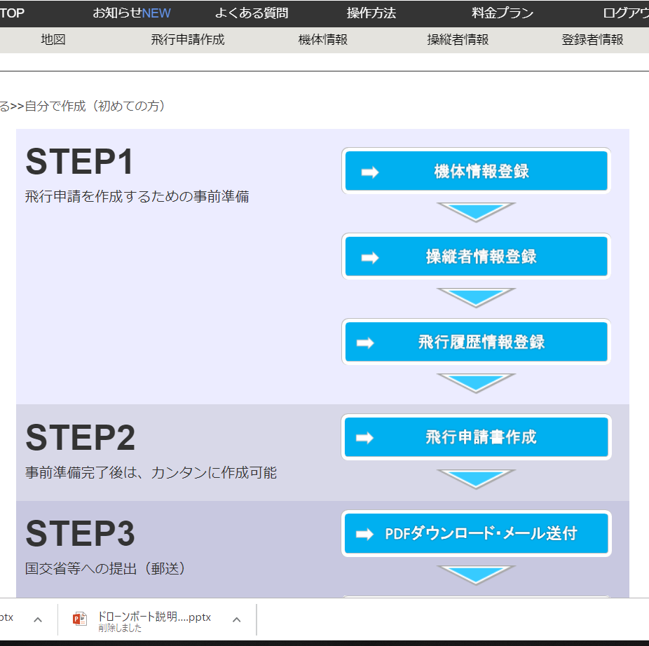
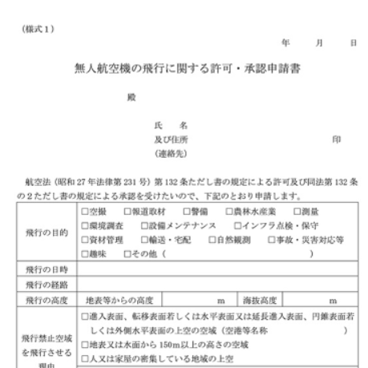
Flight Map Service - SORAPASS
from December 2015
Flight
Management
Permit
Application
Air Traffic
Weather
3D Map

Slide 11



Drone Record & Insurance SORAPASS Care
from December 2018
Flight Area
Recommendation
Self-location
Sharing
Nearby Drones
Notification
No Fly Zone
Basic
Function
Insurance
Function
Personal Right
Infringement
Compensation
Accident Cause Investigation
Quick Vitim Response
Accident Prevention Compensation

Slide 12
Future of JUIDA & Drone Industry in Japan

Slide 13
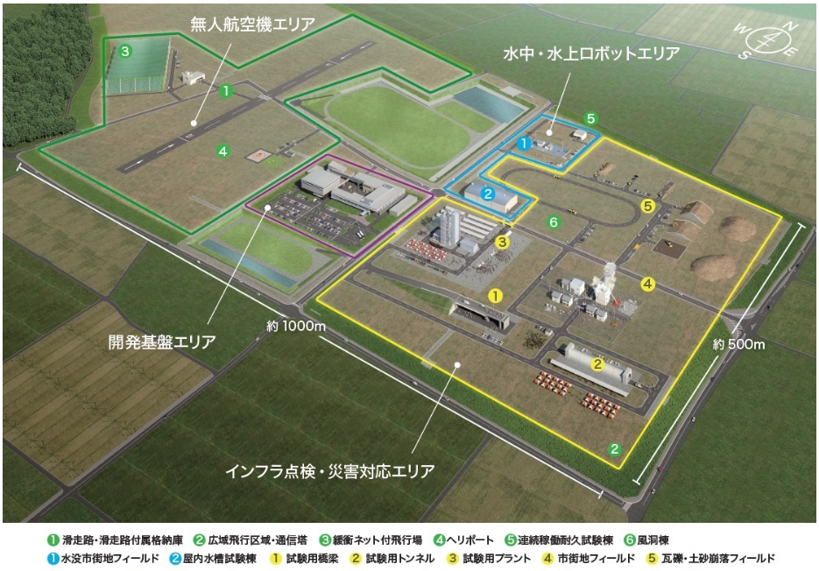
Fukushima Robot Test Field
Opening: 2020 Spring

Slide 14

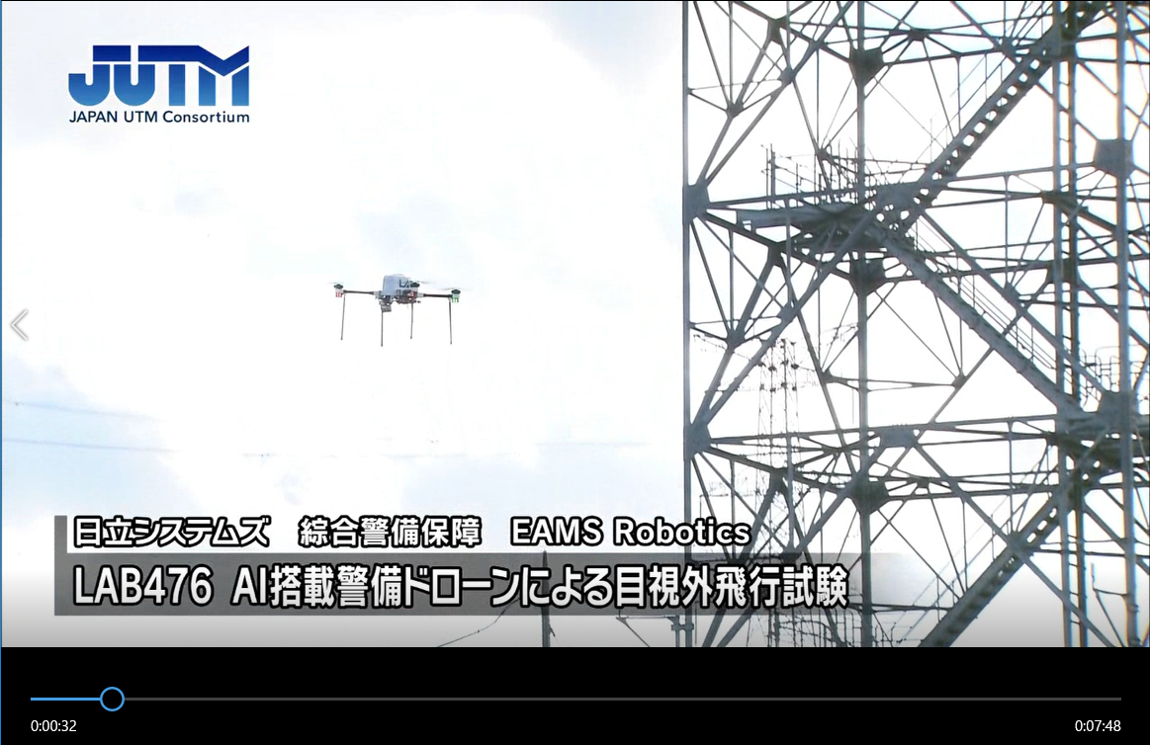
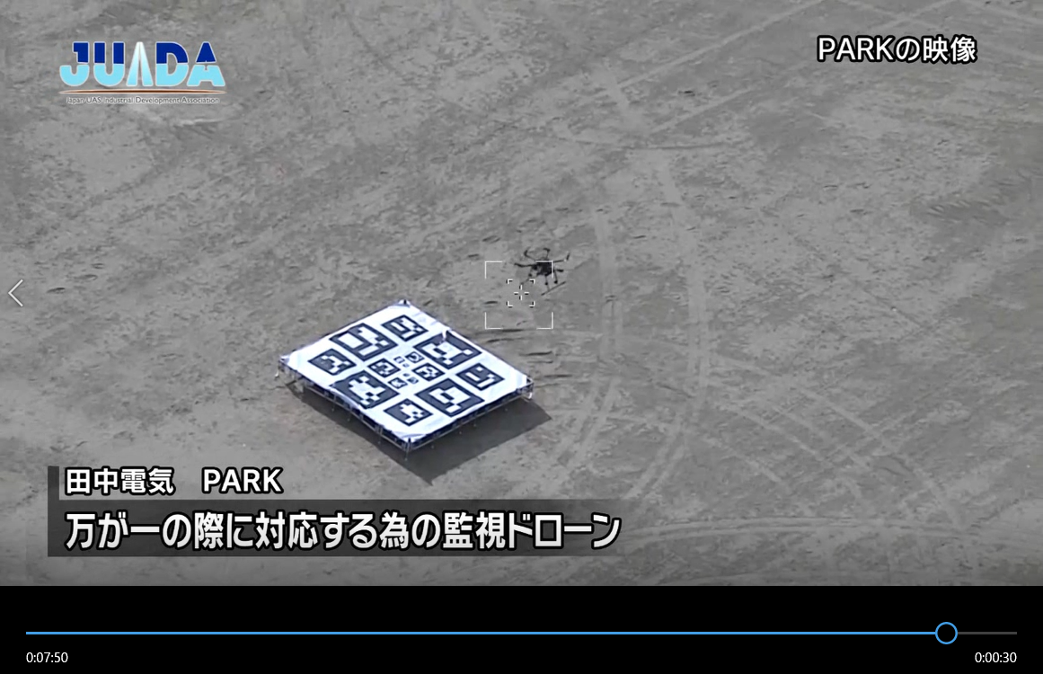
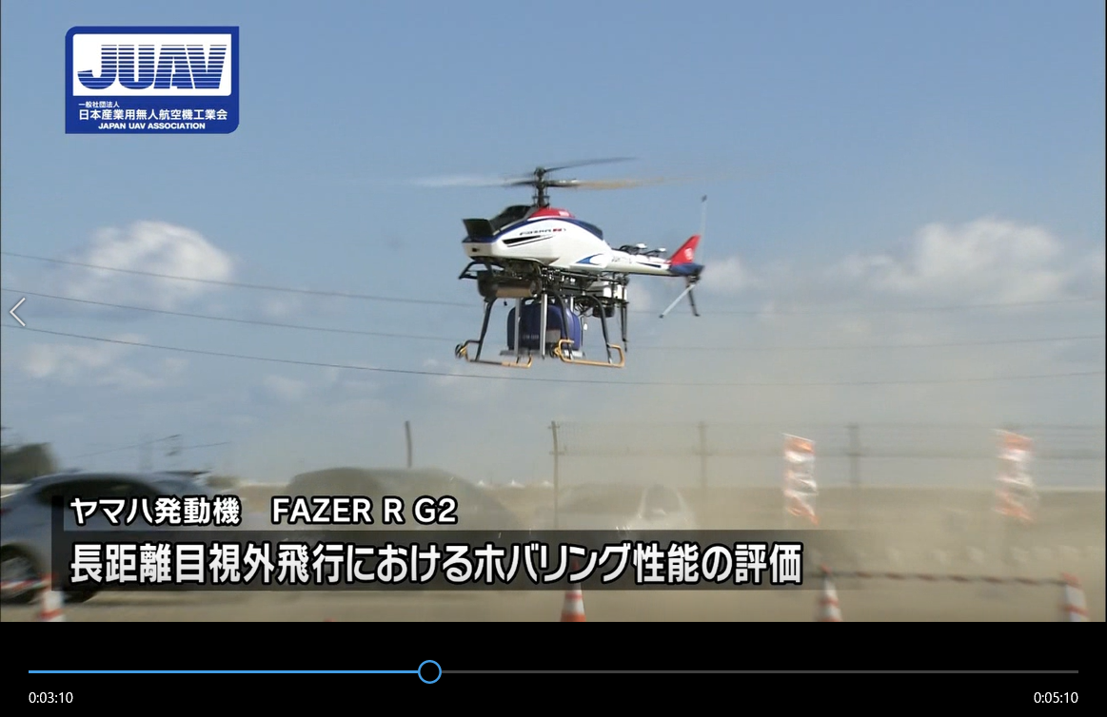
Fukushima Robot Test Field
In January 2019, a series of experiments were carried out in Fukushima Robot Test field by JUIDA, JUTM & JUAV.

Slide 15
Proposal for the Realization of BVLOS &
3rd Party Airspace Flight
Liaison Committee Meeting
among ministries relevant to small-scale UAV
Report
Public-Private Committee
for environmental improvement for small-scale UAS
Report
Formulation of
Logistic Application Guidelines
Revision of
Examination Procedure
based on aviation law
Formulation of
Performance Evaluation Standard for UAV
International Standardization
for UAS
MLIT
Logistic Policy Division
MLIT
Civil Aviation Bureau
METI
Industrial Machinery Division
METI
Industrial Machinery Division
METI
ISO Division
NEDO
JSA
Liaison Meeting
For logistic drone port
Review Meeting
For UAV BVLOS & 3rd party airspace flight
Review Meeting
For UAV performance evaluation Standard
International Standardization Committee
Cooperate
Logistic Subcommittee
Logistic
Disaster Response
Inspection for Infrastructure
Report
Test
Fukushima Robot Test Field

Slide 16
Japan aims to establish a drone license for BVLOS flights by 2022
JUIDA, already managing a system of accredited drone schools in Japan is in discussion with the ministries involved to help set up the bases of such new license system.
Japan faces specific problems related to an aging population and a shortage of workers.
Drone licenses for BVLOS flights would open up the increased use of UAS for purposes like delivering medicines and daily necessities or assisting security patrols.
A bill shall be submitted sometime next year to the Diet in order to start the revision of the Civil Aeronautics Law.

Slide 17
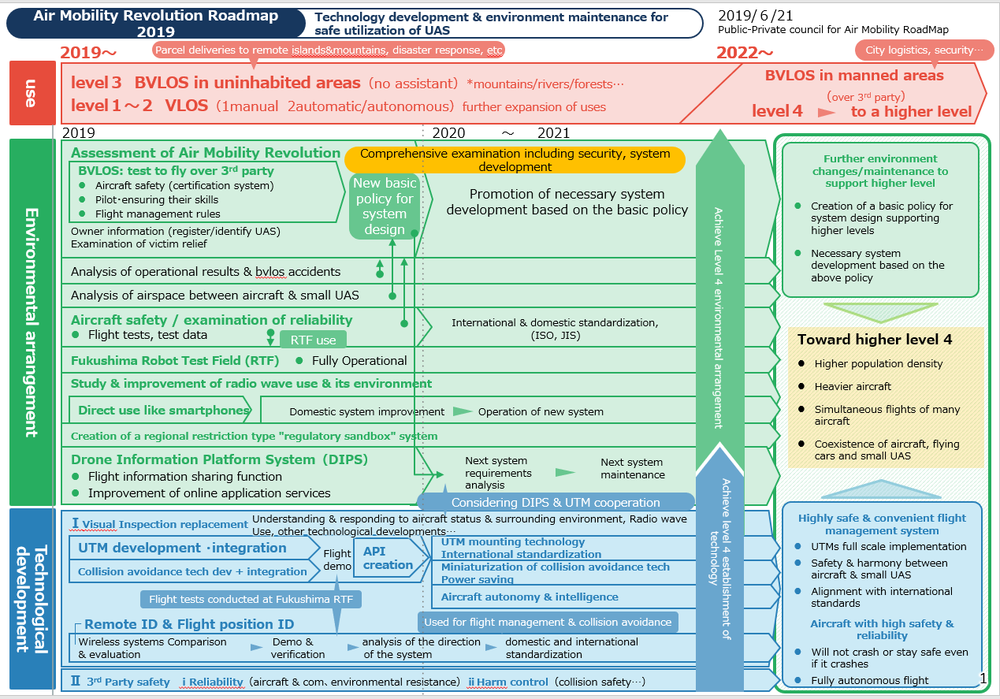
Roadmap for Air Mobility Revolution in 2019

Slide 18
Roadmap per sector
Operational guidelines of each sector to develop their use in the future
Uses & goals
logistics
2019
2020～2021
2022~
Parcel delivery to remote islands & mountains
Delivery of daily necessities & medicine in difficult land transport areas
Creation of parcel delivery business in remote islands & mountains
Expansion of parcel delivery services in remote islands & mountains
PL, multiple aircraft…
Parcel delivery in areas including cities
Demo experiment of parcel delivery in urban areas
Realization & deployment
（from low population density to high density ones）
Disaster response
Understanding the crisis situation
Automate situational awareness using drones and accelerate on-site introduction in response to disasters such as landslides
Establishment of disaster prevention & response in dangerous areas difficult to access
（provide information to related organizations / Training for real-time situational understanding in non-human zones ）
Support for disaster response activities (rescue, etc.)
Support for activities such as transportation of materials and equipment at disaster sites
Supporting activities by transporting more sophisticated equipment at disaster sites
Implementation of utilization situation survey of UAS in case of disaster
Provide education & training for safe & efficient operation
Collect information on technological trends & advanced utilization status, research & promote effective utilization measures
Assess the status of disasters from the sky and monitor water discharge by flying outside the unmanned area with a flight-type reconnaissance/monitoring robot that composes a fire-fighting robot system.
(Rescue missions at the landslide disaster site)
Examination of sensors and analysis methods for assessing situation at night by collecting and analyzing activity cases
Development of sensor and analysis method by technical verification test
Development of operation methods by test operation at disaster site
（Rescue / Search）
Planned maintenance of material & equipment
Examination for further utilization
Maintenance of material & equipment
Deploying small UAS to initial response unit of Ground Self Defense Force
Used for SDF disaster dispatch missions
Additional deployment of small UAS to initial response unit of Ground SDF
Used for SDF disaster dispatch missions
Used for SDF disaster dispatch missions
（Petroleum complex fire/explosion disaster countermeasure robot system demonstration deployment)
Training/disaster dispatch, examination of establishment of efficient usage
Training/disaster dispatch, formulation of efficient usage, demand increase (continuation)

Slide 19
Road map per sector
Agriculture, forestry and fisheries
2019
2020～2021
2022~
Agriculture
Widely confirm the growth status of crops in each farmland
【 Field sensing 】
Confirm crops, field boundaries…（implemented since 2018）
Technological development to distinguish crops, land boundaries, land damage status via aerial images.
Confirm crops, field boundaries…
Develop software for social implementation (from 2021)
Sensing of vegetable growth & pest occurrence status (since 2018）
Development of a vegetable growth prediction application that uses aerial image analysis, weather information, and growth prediction
Sensing of vegetable growth & pest occurrence status
Implement growth prediction/diagnosis app for each field
Expansion of application of growth prediction & diagnosis app to other vegetables (from 2023)
Development of method for estimating pest outbreak situation by aerial image analysis
Field demo of pest occurrence situation estimation
method by aerial image analysis
[Agricultural chemical application]
Fruit tree chemical spraying tech & sensing of pest occurrence status (since 2018)
Automatic navigation is possible in
steep slope orchards / Drone development
Fruit spraying tech & sensing of pest occurrence
Implementation & spread of pesticide spraying technology in steep slope orchards (from 2023)
Demo of pesticide application in steep slope orchards (verification & improvement until 2022）
Development of aerial photography technology required for pest judgment (including verification of image resolution, required number of shots, etc.) (Until 2021)
Necessary for predicting pest occurrence from images
Determined sensing data specifications (2022)
Sequential review of guidelines for aerial spraying in line with technological progress
Develop a disease outbreak diagnosis system and implement and spread it on site (from 2023)
Relaxing obligation to have observers while doing drone spraying on lands
Development of related notifications regarding aerial spraying of agricultural chemicals
Expansion of pesticide application area to 1 million hectares
【Fertilizer application】
Implement & spread fertilizer spraying tech
Development & demo of fertilizer suitable for drone spraying
Implement & spread fertilizer technology
Implementation and dissemination of open-field vegetables to advanced management bodies
【Seeding】
Creation of sowing tech
Establishment & verification of uniform spraying technology
Implement & disseminate seeding tech
Implementation/dissemination of paddy production to advanced management bodies
【Pollination】
Creation of pollination tech
Technological development such as improvement of spraying equipment
Implement & spread pollination technology
Implementation & dissemination of major fruit trees in advanced management bodies
【Transportation of harvested goods】
Implement & disseminate harvest transportation technology
Implement & disseminate open-field vegetables, fruit trees, etc. in advanced management bodies
Creation of harvest transportation tech
Establishment & verification of technology for long-time and long-distance flight

Slide 20
Road map per sector
Agriculture, forestry and fisheries
2019
2020～2021
2022~
Agriculture
【Damage prevention to birds & animals】
Creation of a method to assess the actual habitat of birds & other beasts
Manual for habitat assessment methods for deer…
Creation of a method to assess the actual habitat of birds & other beasts
Implement & disseminate habitat status monitoring system
Automation of traps to capture wildlife
Development of automated bait dropping technology in and around the box trap
Automation of traps to capture wildlife
Demonstration test of automated food dropping technology
Automation of traps to capture wildlife
Implementation and spread of automated bait dropping technology
Forestry
Understanding forest damage (hillside collapse, pest damage, weather damage, etc.)
Use of drones by all prefectures and forest management offices to understand forest damage by 2022
Understanding forest resource information
Develop high precision tech to assess forest resource using aerial image & laser sensing (since 2016)
Demo in the above model area (since 2018)
Implement & disseminate technology to assess forest resource information
Based on the use of remote sensing technology
Examination of design & enforcement management methods for afforestation projects
Based on the use of remote sensing technology
Dissemination of design and enforcement management methods for afforestation projects
Demonstration of utilization technology for transportation of seeds and sowing
Fishery
Prevention of damage to fisheries by cormorants
Development of cormorant repatriation technology
Development of a manual of reproductive control technology for Great Cormorant
Prevention of damage to fisheries by cormorants
Dissemination of Cormorant Discharge Technology & Breeding Control Technology
Develop visual survey tech for whales
Demo of stable takeoff & landing tech on
survey ship
Identification of whales & demo of the
number of individuals included in the herd
Demonstration of collection of DNA samples
(fumes and skin specimens)
Develop visual survey tech for whales
Validate data by comparing the results of a drone
survey and the visual survey from the ship
Disseminate survey methods to the field (from 2022)）

Slide 21
Road map per sector
Infrastructure maintenance
2019
2020～2021
2022~
BVLOS inspection of vast structures
Infrastructure inspection in urban areas
Create & use highly accurate data detection & recording system
Create & use remote position tech under disturbances like wind/rain
Create & use automatic safety control technology
Improve drone pilot skills and secure human resources
Verification of short-distance patrols and inspections within mountains
Short distance patrol in urban areas ・
Examination of inspection method
Demonstration and evaluation of infrastructure
inspections using drones, etc.
Wide-area inspection of bridges, buildings, roads, power lines…
Examination of medium-distance patrol/inspection methods in the mountainous area, etc. (visualization for expansion of cruising range)
Verification of short distance patrol in urban areas
Demo/evaluation/use in line with tech progress
Started automation of inspections using drones for maintenance of eroded facilities
Accelerate introduction to sites such as
erosion control facilities
Surveying
Real-time survey by laser surveying
High value-added surveying with hyperspectral camera
Surveying in urban areas (manned areas)
Support use of UAS in public surveys, e.g: publicizing work manuals
Promotion of utilization in construction surveying
The third basic plan for promoting the utilization of geospatial information
Reflecting the UAV Photogrammetry Manual (draft) in the rules of work regulations
Revision of UAV laser surveying operation manual (draft)
Accurate grasp of 3D topography survey & promotion of 3D data creation
Reflecting the UAV laser surveying operation manual (draft) in the rules of work regulations
Security
Intrusion monitoring and patrol monitoring of wide areas and manned areas
Intrusion monitoring and patrol monitoring on site
Performance evaluation in RTF, safety certification of aircraft & equipment by private sector
Promotion of various verification tests
Advanced real-time image collaboration
Dissemination of utilization status in security operations
Wide-area patrol for urban areas
Promotion of use for wide-area security in security ops
Improving the quality of the security industry by
improving image analysis technology

Slide 22
Safe drone flights by measuring wind speed / logistics
The high-performance atmospheric measurement device "Doppler Rider" developed by Metroweather Kyoto University will be installed in the telecommunications towers and stations that NTT Communications has deployed nationwide.
It is about 1 meter, which is about 90% smaller than general equipment, and can be placed on the roof of a building or a steel tower.
It will analyze the movements of the wind every 100 meters so that logistics companies can avoid strong winds and fly drones in urban areas safely.
Effectively, the wind speed and direction will be observed in real time and presented as 3D data on a map in an easy-to-understand manner.

Slide 23
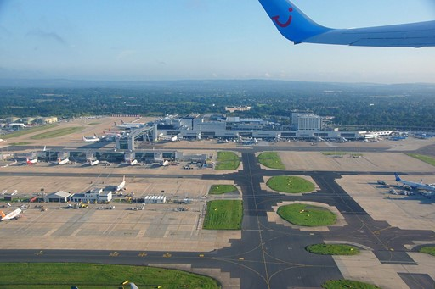
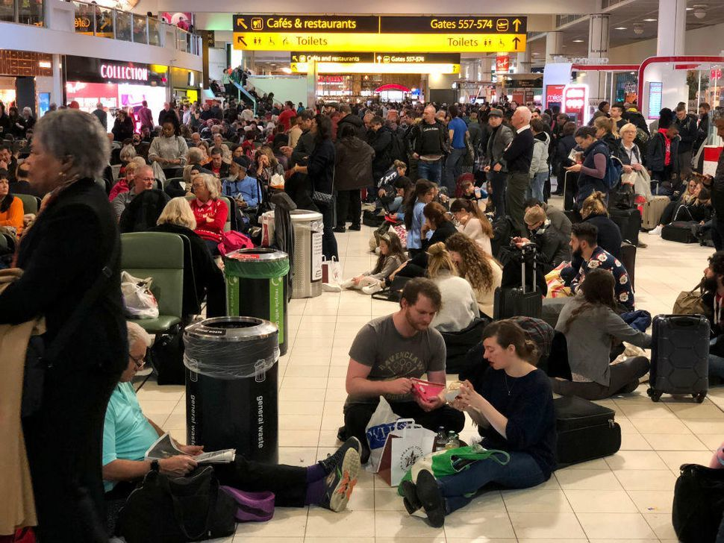
Gatwick Airport drone incident
Drone witnessed at Gatwick airport, blocked for two days
Ethics education for Drone use should be done in school.

Slide 24
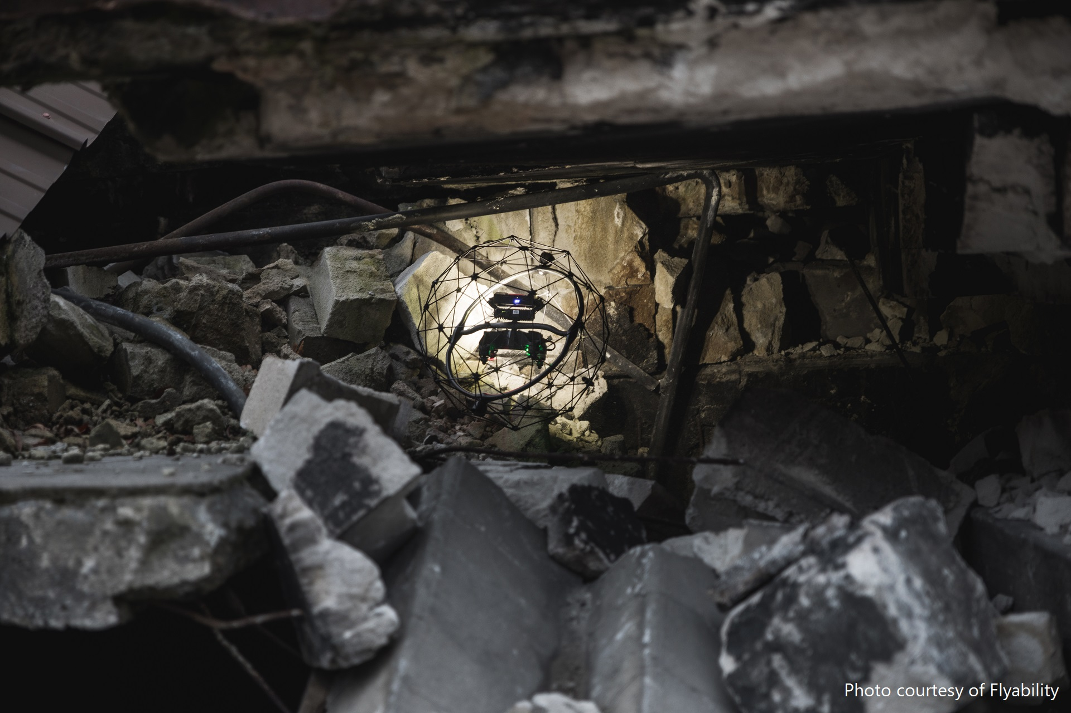
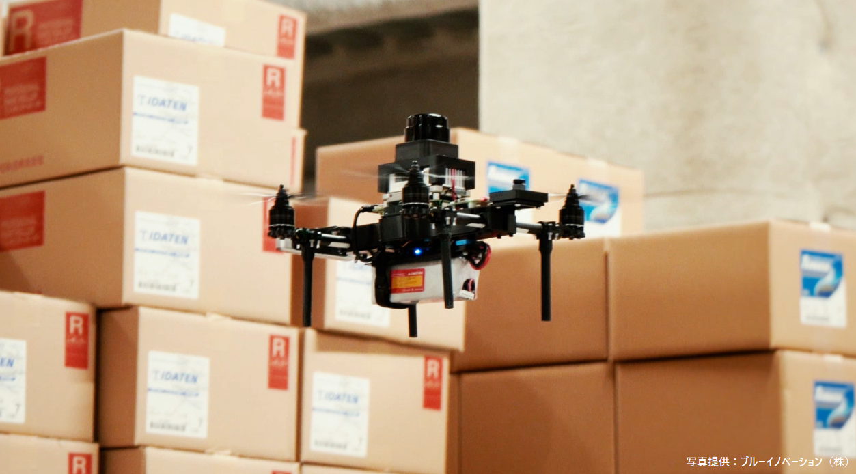
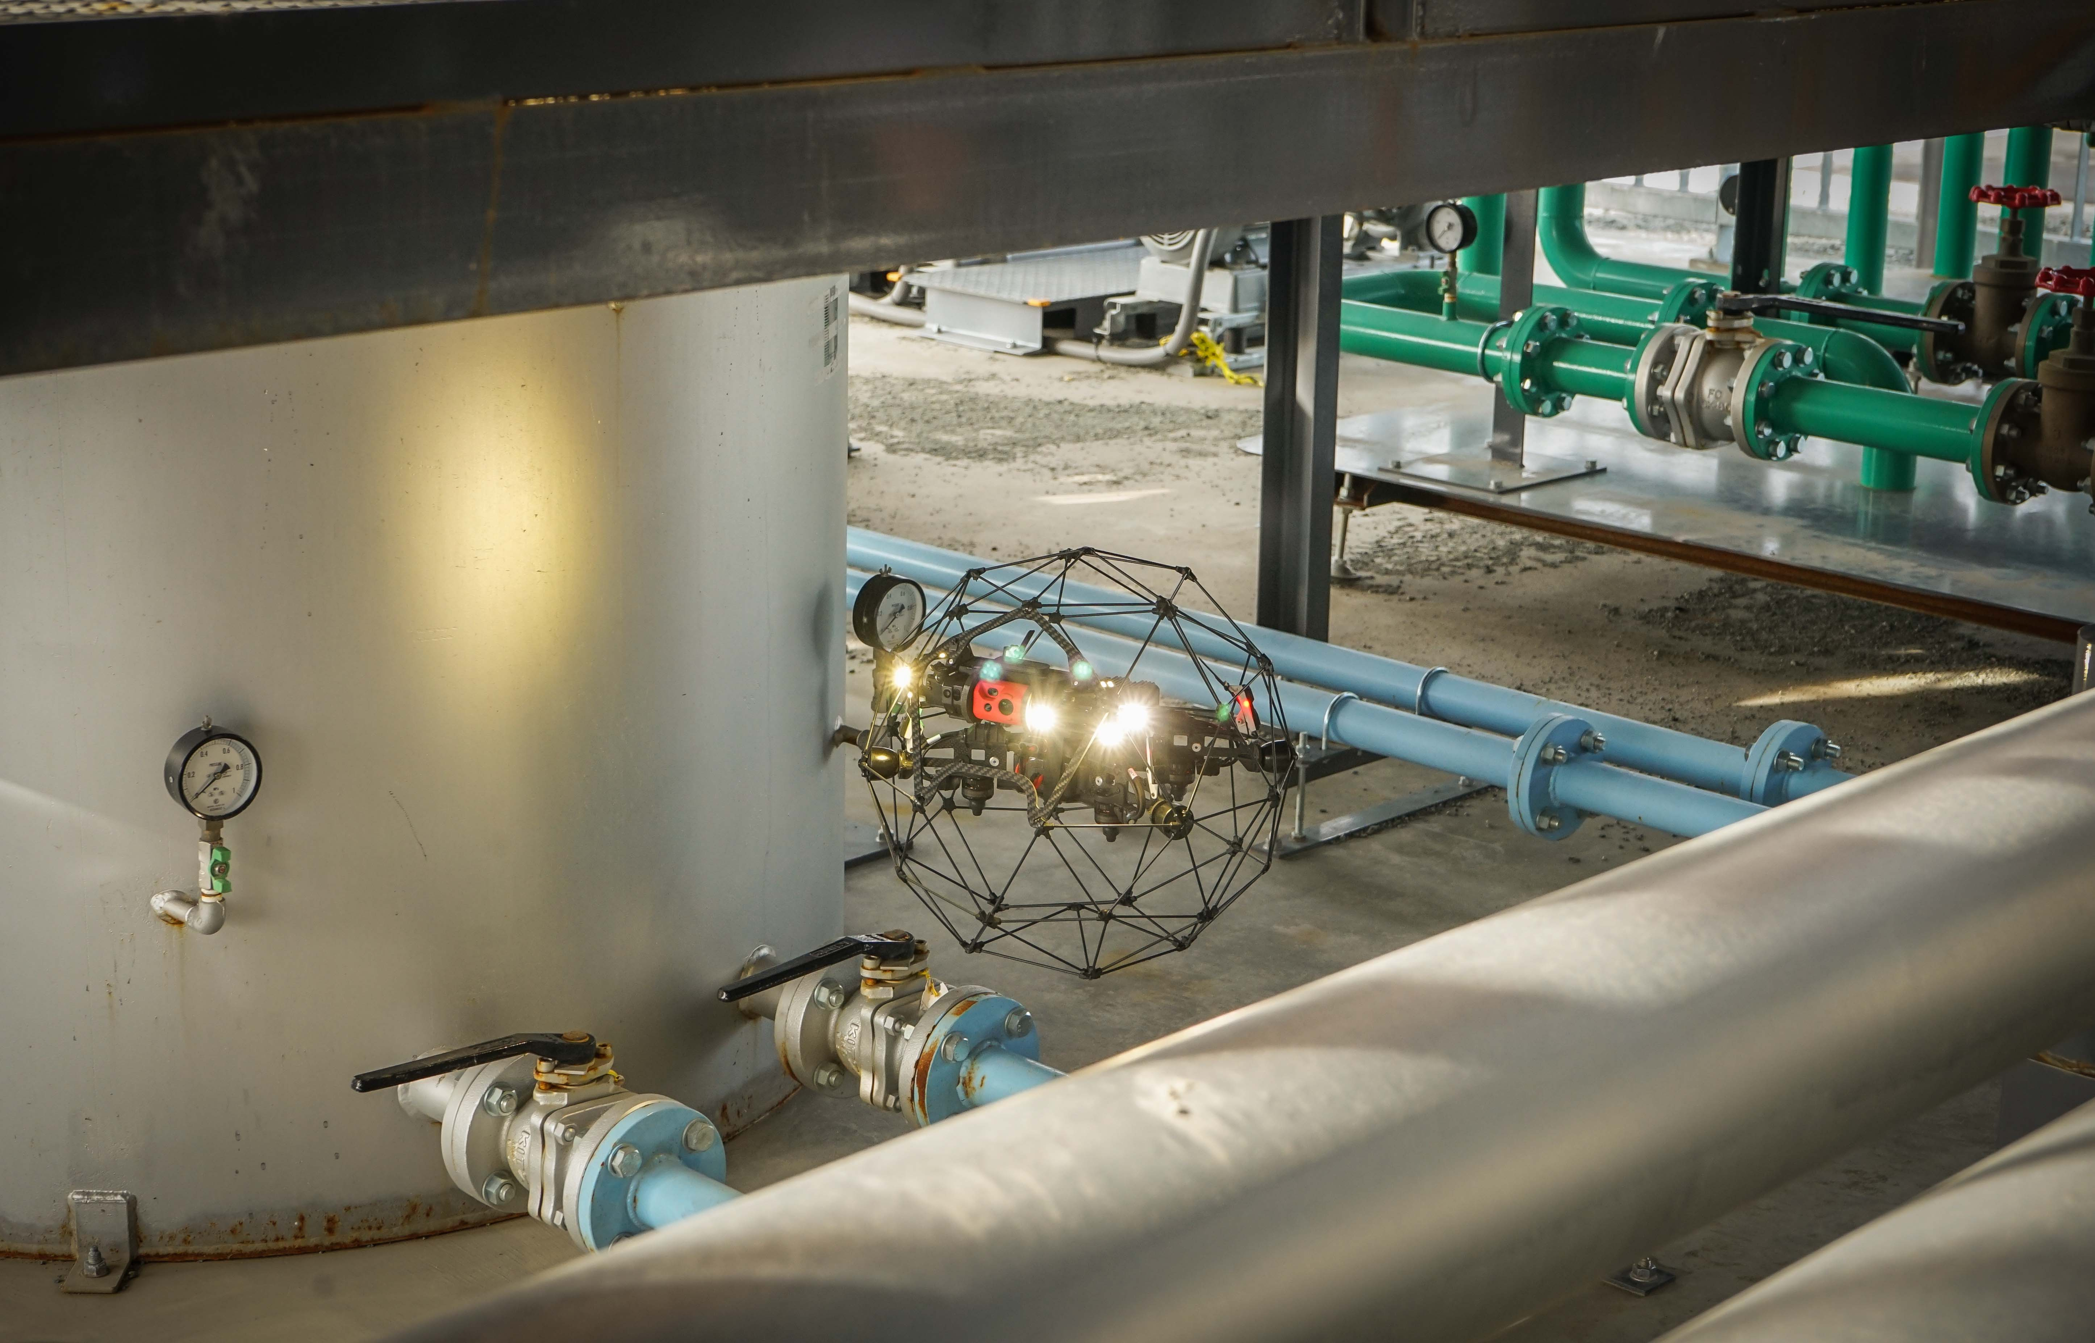
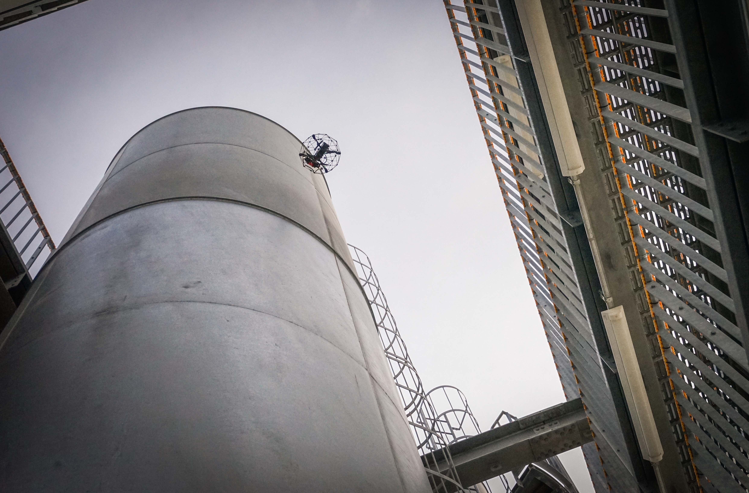
Measures to prevent misuse of UAS for infrastructure inspection

Slide 25
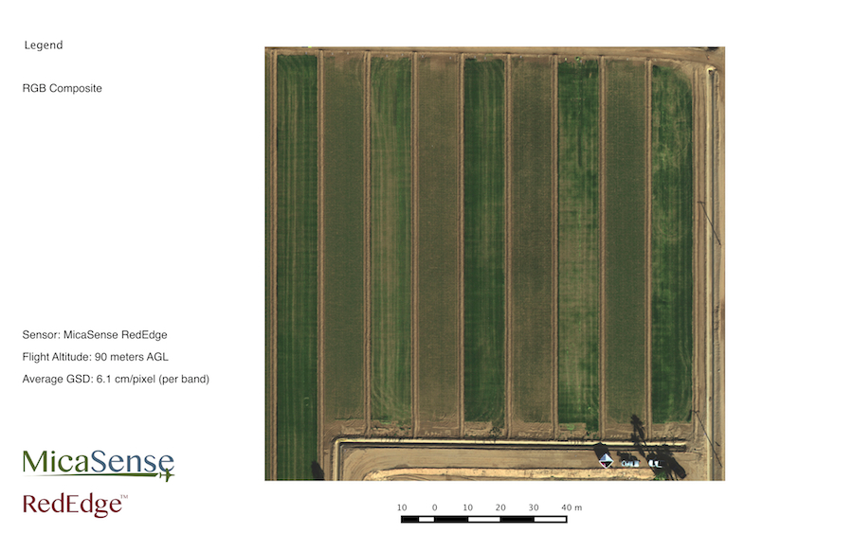
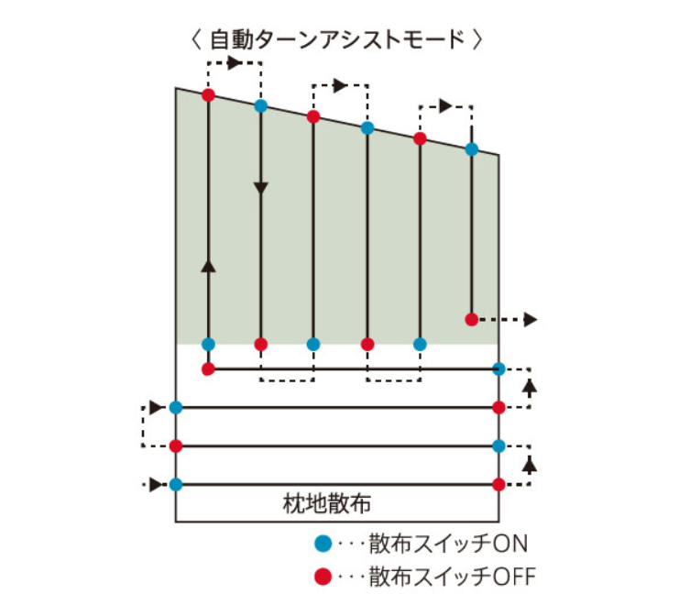
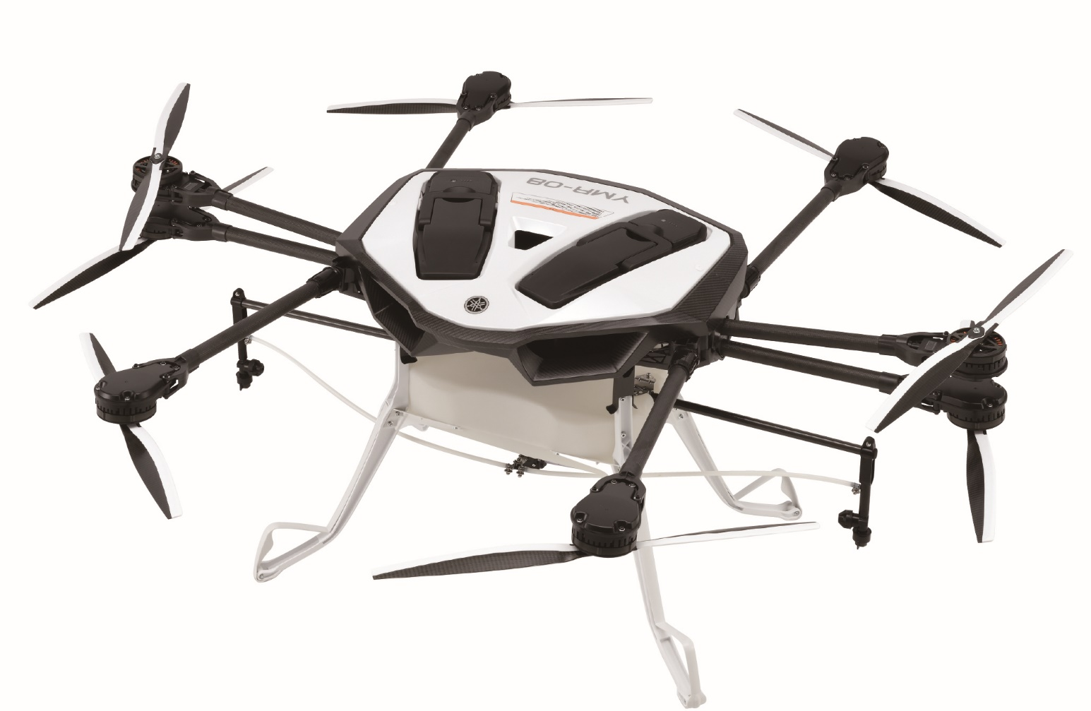
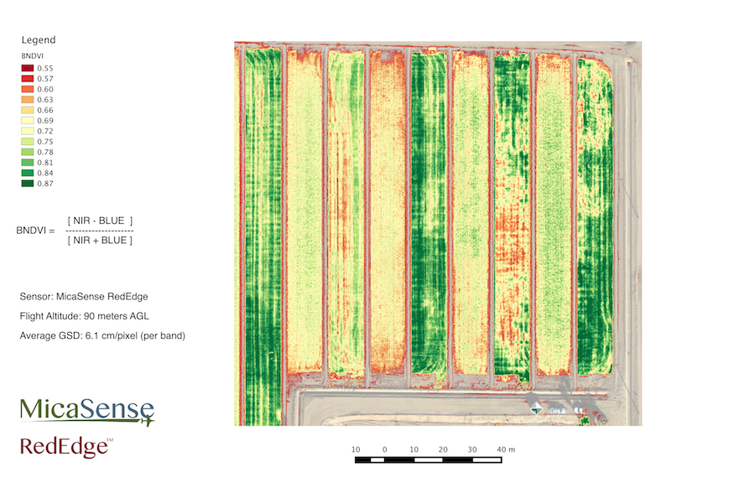
Measures to prevent misuse of agricultural UAS
The Ministry of Land, Infrastructure, Transport and Tourism is responsible for permitting the transportation of dangerous materials and the release of airborne materials.

Slide 26

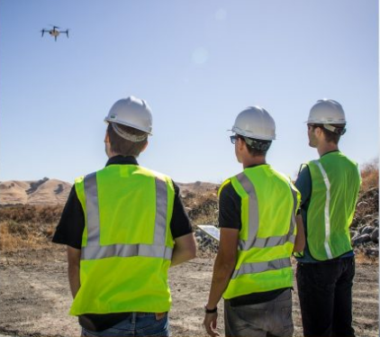
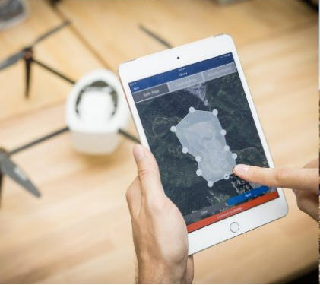
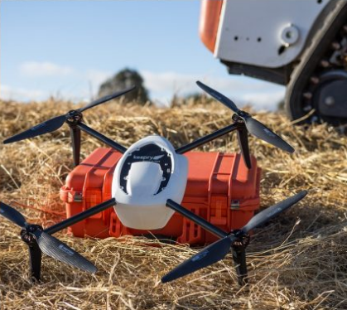
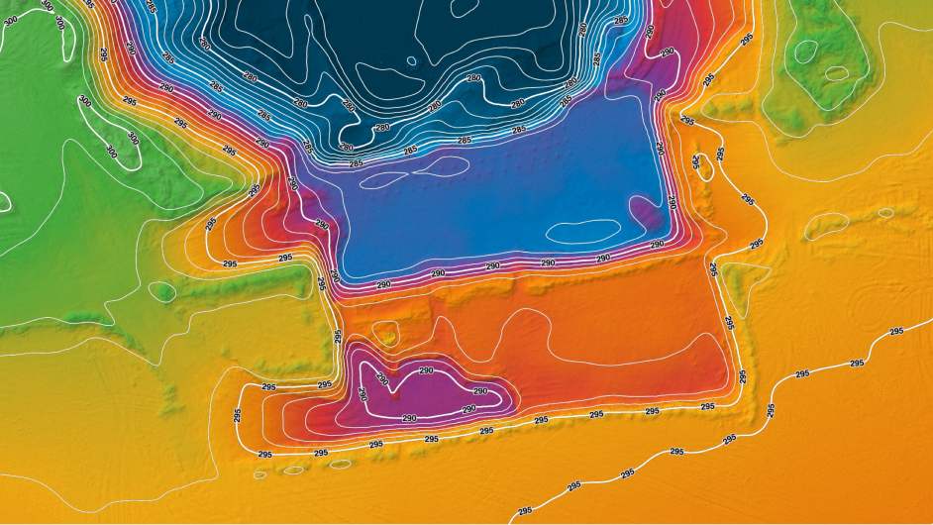
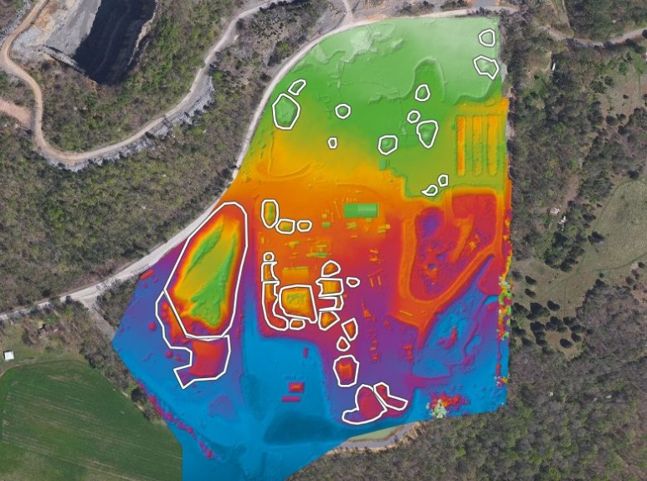
Measures to prevent misuse of surveyed UAS

Slide 27

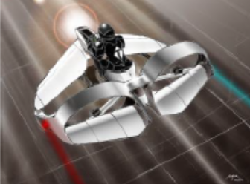
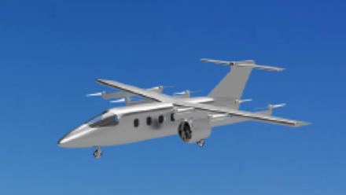
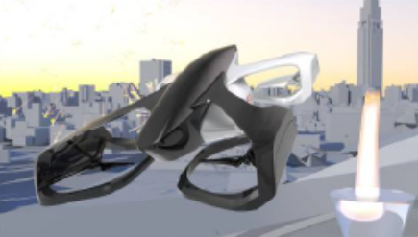
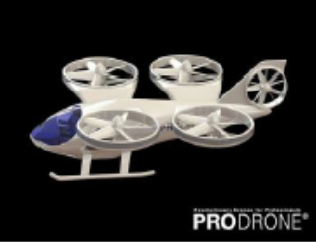
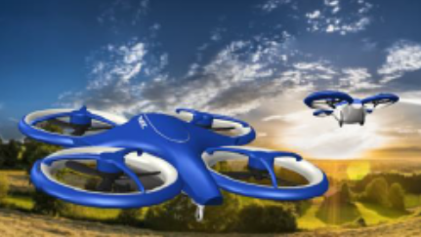
Manned Flying Vehicles
Drone Fund
Ministry of Economy, Trade and Industry is working on the R&D of manned flying vehicles, for its potential to ease the problem of jammed traffic, and the transport of goods for logistics and during disaster. A public and private sector council is set up.
Source: METI Press Site http://www.meti.go.jp/press/2018/08/20180824001/20180824001.html

Slide 28

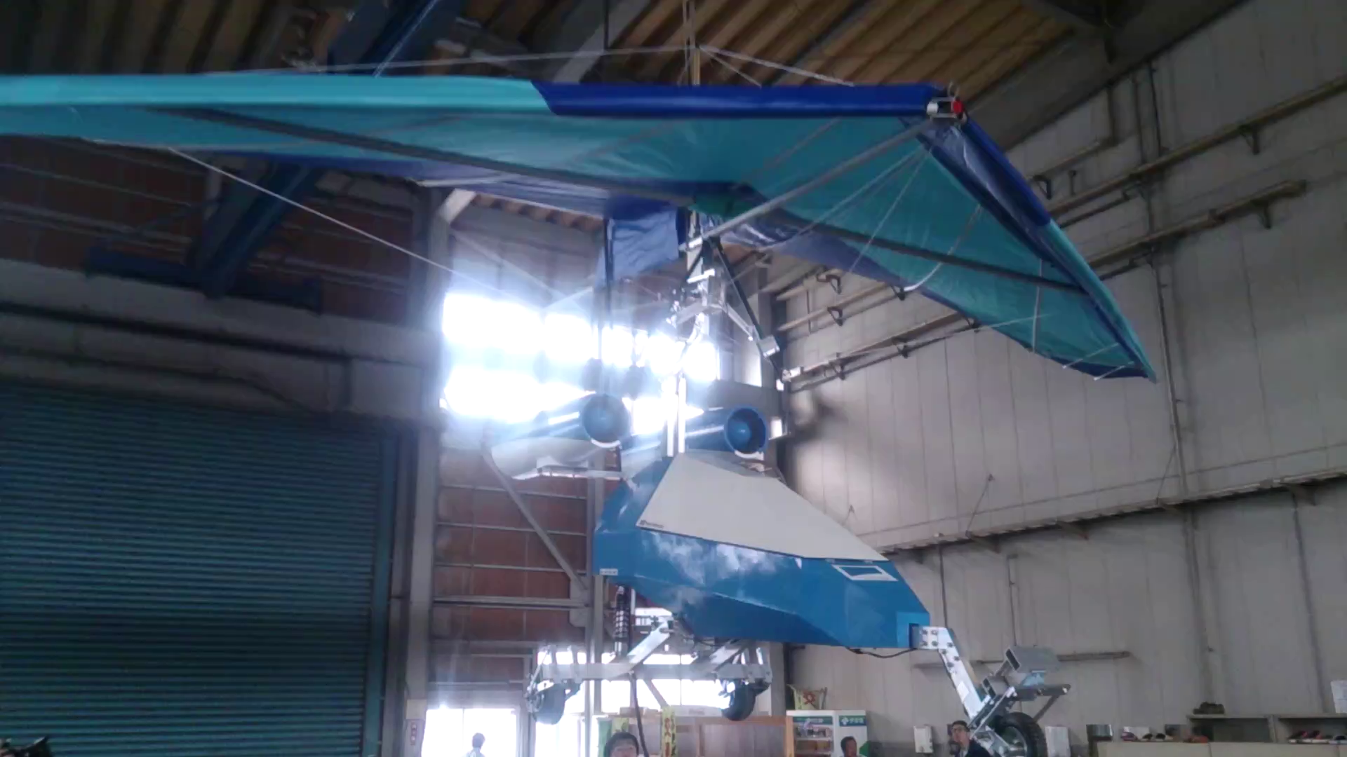
Flying car (static balance test)
Flight experiment video： https://staff.aist.go.jp/k.iwata/UAV/NSP-UAV.mp4

Slide 29
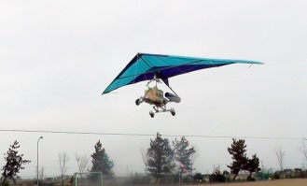
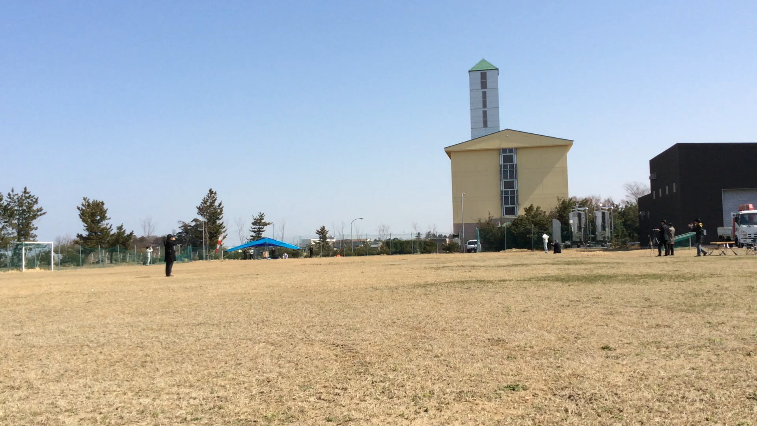
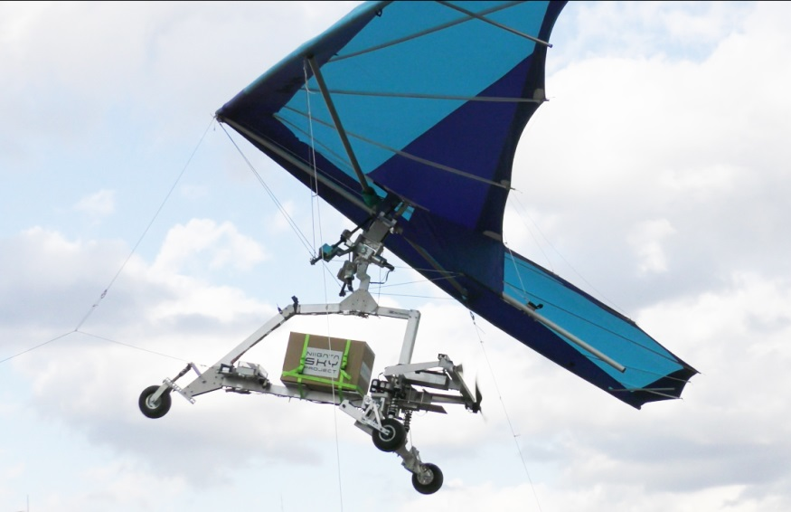
Research and development of flying cars
Flight test video： https://staff.aist.go.jp/k.iwata/UAV/CargoUAVflightTEST.wmv

Slide 30
Summary
What is the bright future of drones？
→ A future where drones are recognized by society
→ Zero anonymity by confirming the identity of the drone and the pilot
↓
Drone operations trusted by society

Slide 31
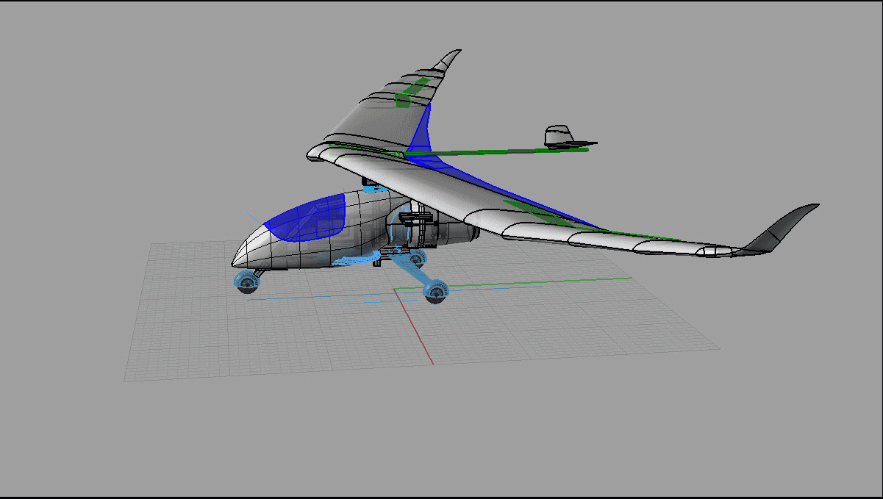
Fin
Thank you!

